Slide 1
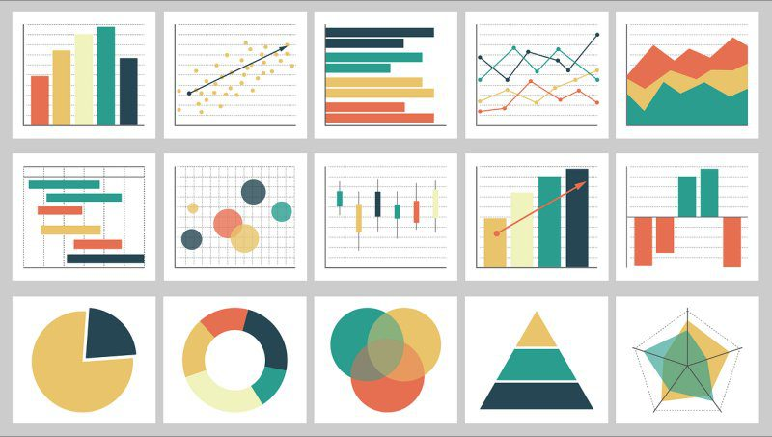
Week 4: Descriptive statistics/Exploratory Data Analysis
Geog4300/6300: Harper
Sept 9, 2025

Slide 2
Where are we?
Reading catch-up:
Wickham and Grolemand Ch 1-3, 5, 7 (optional: 4, 6, 8)
Wikham and Grolemand Ch 21 (Databases)
This week: Read McGrew et al. Chapter 3 (Descriptive statistics and graphs)
Work on scripts on your own time if we’re not getting to them in class. Ask questions during ‘lab’ time (5:10-5:35 both days) or book a time with me or Ummie.
Lab 1: Due Thursday

Slide 3
Know your variable types
Nominal/categorical: non-ordered and qualitative
Geographic regions, land use classifications
Ordinal: qualitative but ranked
Months of the year, storm intensity
Interval: Quantitative but without a meaningful zero
Temperature, years
Ratio: Quantitative and divisible
Rainfall amounts, program budget amounts
Notes:
Ordinal data can be used in surveys (ie Likert)
Interval

Slide 4
What kind of data is it?
Letter grades on an essay exam
Birth year of graduate students in a department
Number of students from each country in a large course
Degree objectives for geography students (BA/BS, MA/MS, Phd)
Flavors of ice cream
Grams of fat in ice cream
% of consumers who prefer particular flavors of ice cream
Nominal/categorical: non-ordered and qualitative
Ordinal: qualitative but ranked
Interval: Quantitative but without a true zero
Ratio: Quantitative and divisible
Notes:
Letter grades: ordinal. Qualititive
Birth year: interval. How to convert that to ratio data: age.
Number of students: Ratio
Degree objective: degree (ordinal), dept (nominal)
Flavors of ice cream: nominal (can you rank them? Haha)
Grams of fat: ratio
% of consumers: ratio, you can have 0%.

Slide 5
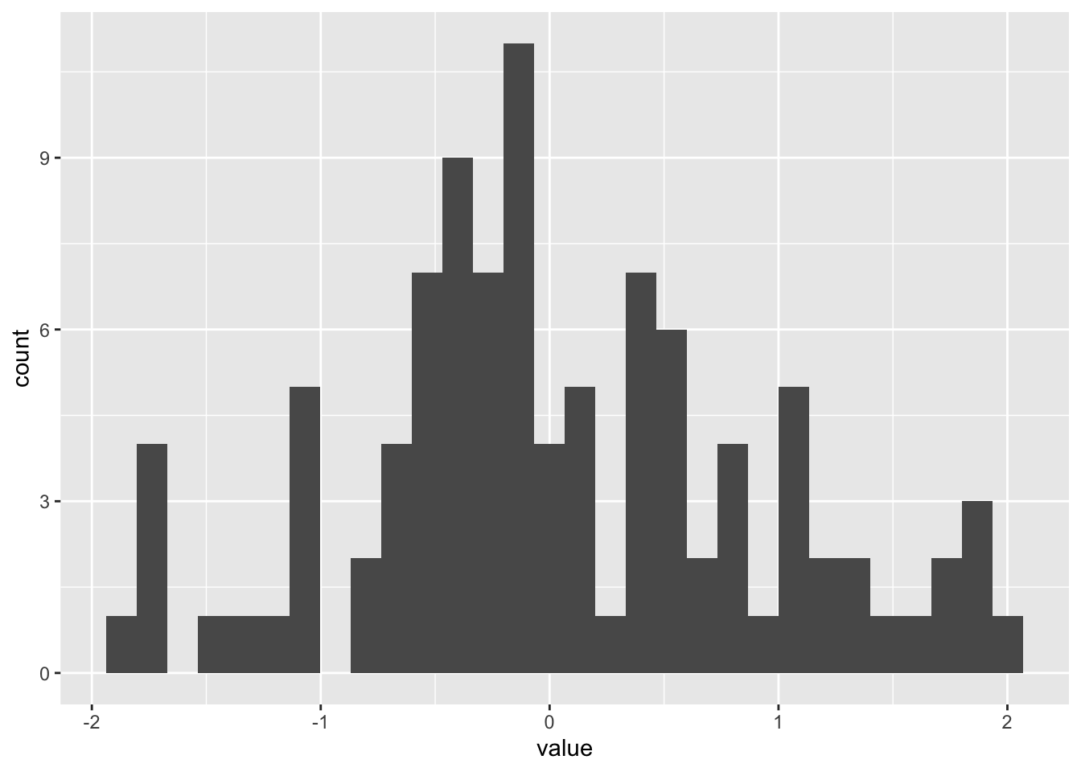
Descriptive statistics
Measures of central tendency:
Mean
Median
Mode
Measures of distribution:
Standard deviation
Interquartile range (IQR)
Coefficient of variation

Slide 6
Which measure of central tendency should we use for the number of UGA football games we have attended? (And how should we wrangle this data before doing so?)
0 | 0
4 | 0
3 | 0
0.5 (I left at halftime) | 0
Seven home games | 0
1 | 0
13 | 0
2 | 4
Almost all home games since 2005, plus 3 or 4 bowl games | 3
0

Slide 7
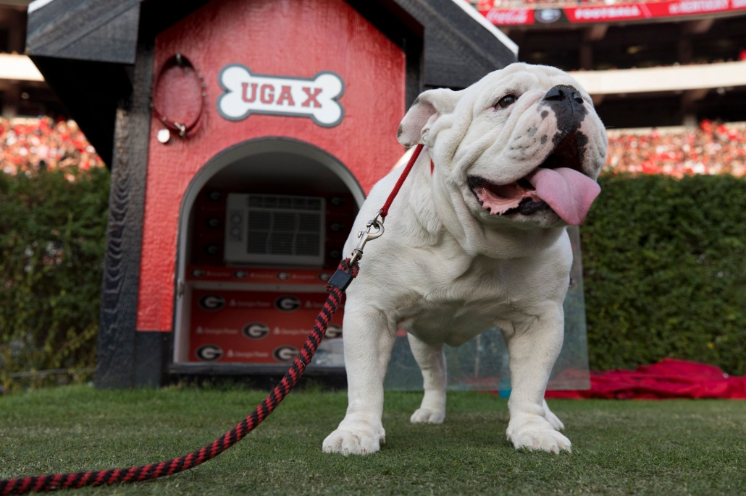
What’s a related question we could ask for which mode would be the appropriate measure of central tendancy?

Slide 8
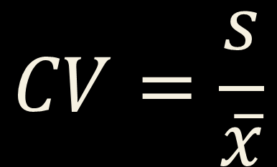
Coefficient of variation
Standard deviation divided by the mean
Useful when means vary across groups or measures
$$CV=\frac{s}{\overline{x}}$$

Slide 9


R challenge!
Load the Daymet data in the class repo: daymet_monthly_median_2010-2021
Calculate the mean, median, standard deviation (sd), and cv for prcp by county. You’ll need to use group_by, summarise, and mutate. Which counties have the highest cv? How does that compare to standard deviation?
$$CV=\frac{s}{\overline{x}}$$

Slide 10
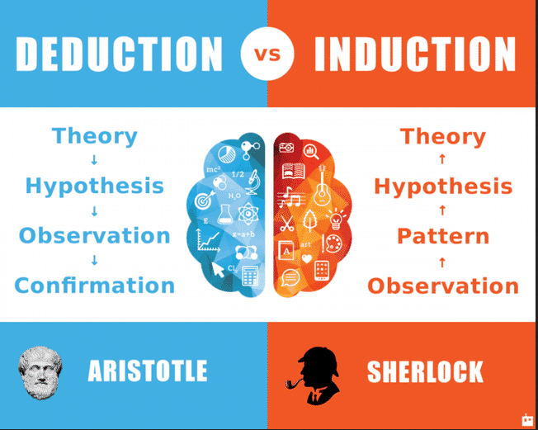
What is exploratory data analysis?

Slide 11
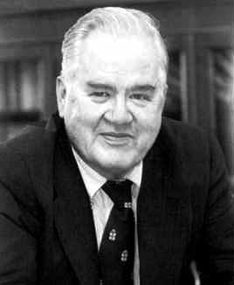
What is exploratory data analysis?
John Tukey
“Numerical quantities focus on expected values, graphical summaries on unexpected values.”

Slide 12
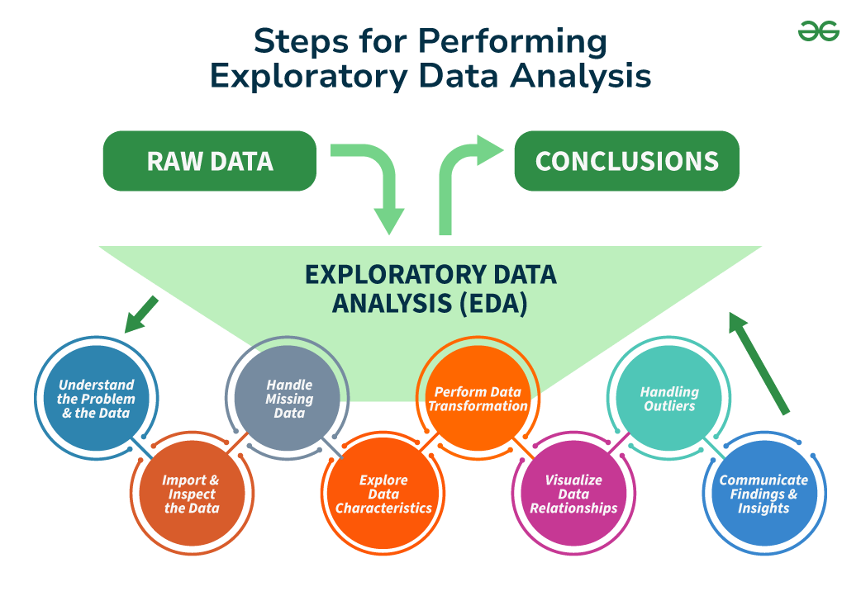
https://www.geeksforgeeks.org/what-is-exploratory-data-analysis/

Slide 13
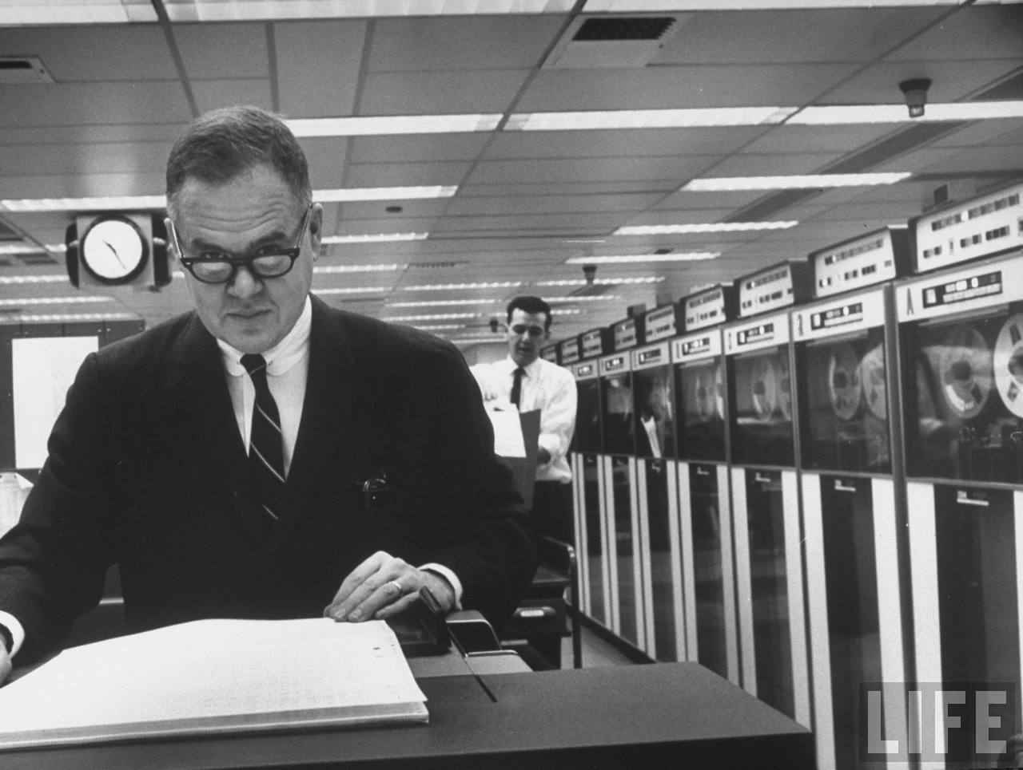

Tukey and Wickham on Exploratory Data Analysis
Notes:
Depending your approach, classification methods can paint very different pictures of the same data points.
How might we interpret the natural breaks map differently from the quantiles map here?

